Slide 1


Slide 2
Welcome to
EDA ON NETFLIX MOVIES AND TV SHOWS

Slide 3
TABLE OF CONTENTS
1. Introduction
2. About Netflix
3. Import Libraries
4. Import Dataset
5. Basic Exploration
6 Dealing with Missing Values
7. Data Visualization
8. Questions Answers
9. Summary
10. Conclusion

Slide 4
Introduction
The Netflix dataset contains information about various TV shows and movies available on the platform, including details like title, type (TV show or movie), release year, country of production, duration, and genre. It provides insights into the diverse content offered by Netflix, facilitating analyses of trends in production, distribution, and viewer preferences.

Slide 5


Slide 6
About Netflix
Netflix is a leading global streaming service offering a vast library of TV shows, movies, documentaries, and more. Founded in 1997, it revolutionized the entertainment industry by pioneering subscription-based video streaming, enabling users to watch content anytime, anywhere. With a focus on original programming, personalized recommendations, and seamless user experience, Netflix has become a household name, catering to diverse tastes and preferences worldwide.

Slide 7
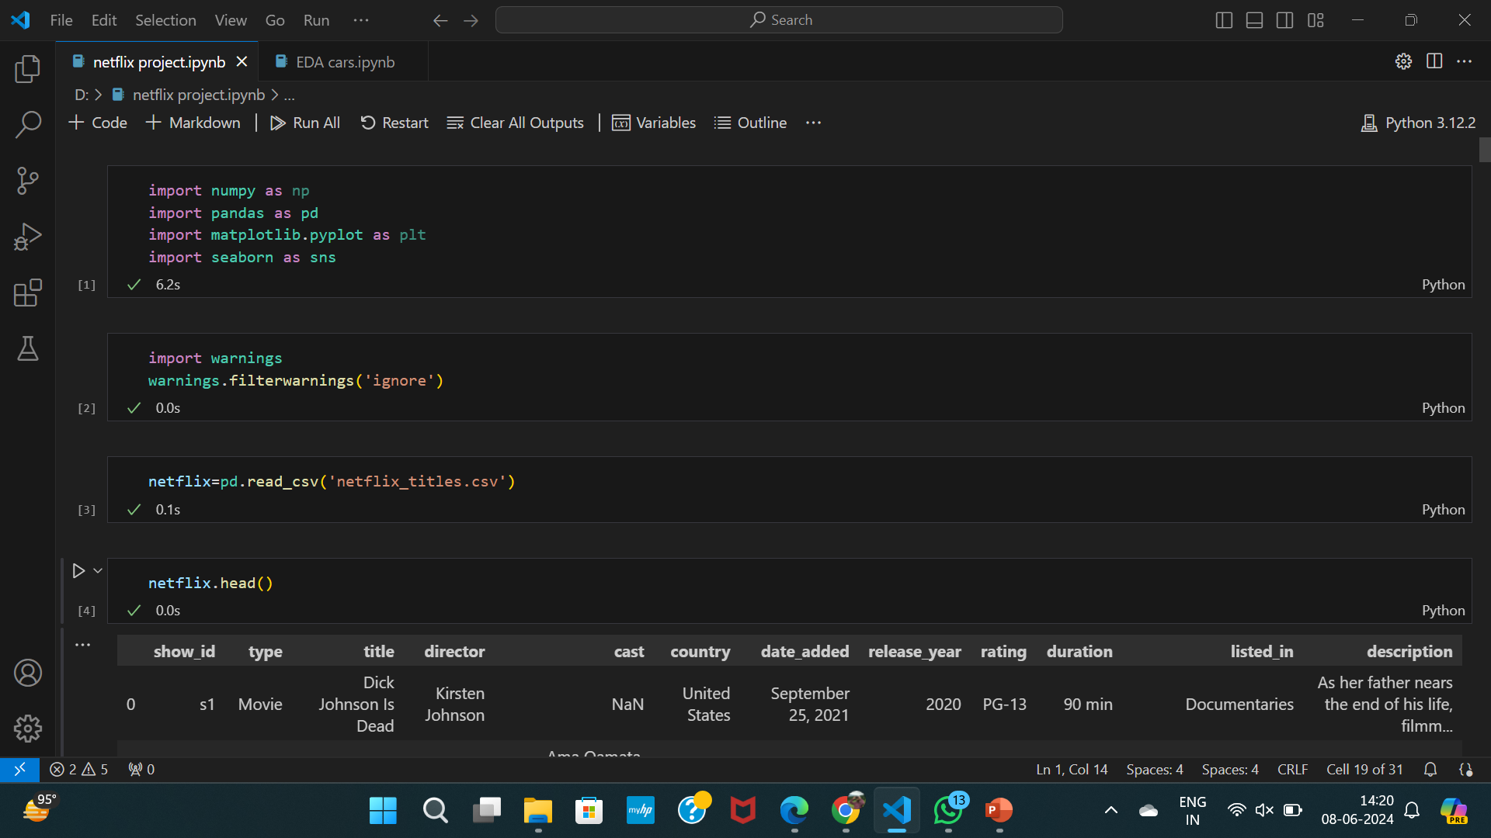
FIRST STEP FOR EDA
Import Libraries

Slide 8
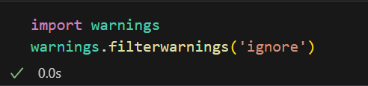
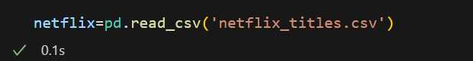
Load dataset
Import warnings
Load dataset

Slide 9
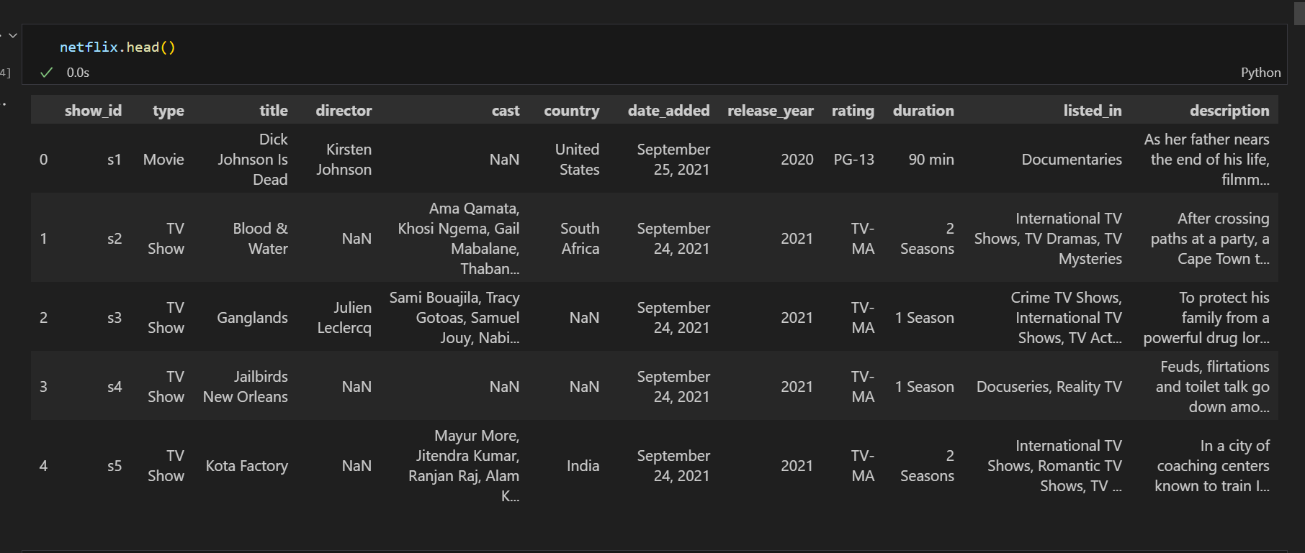
Basic eda (to find first 5 records)

Slide 10
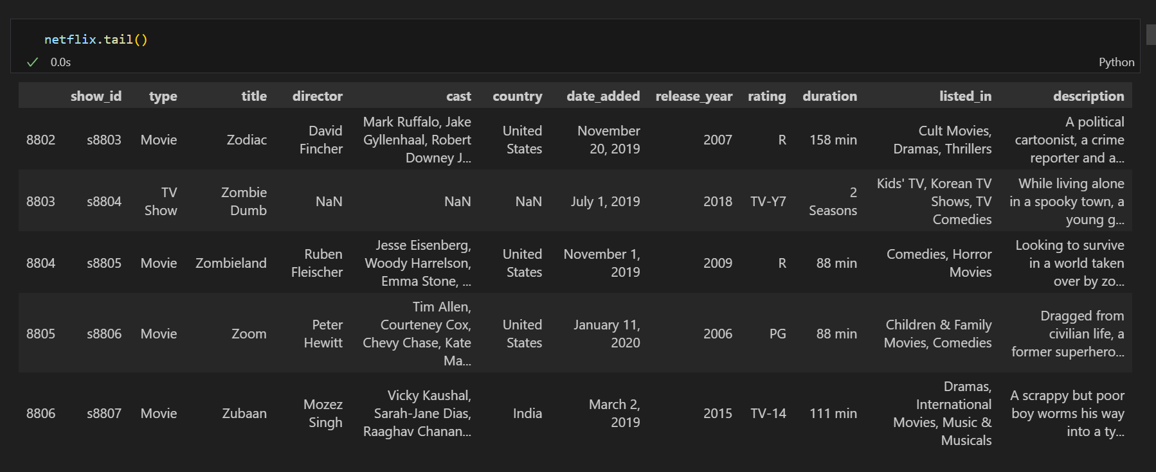
to find last 5 records

Slide 11
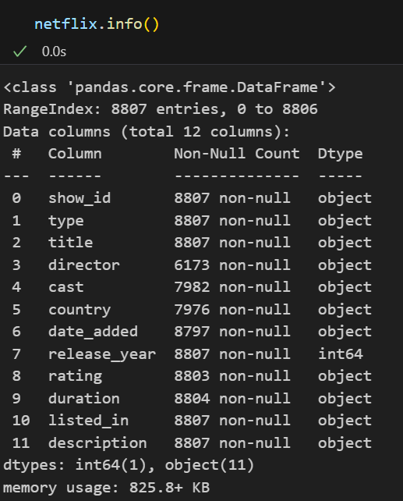
To know data about columns
By checking info function we can find that there are 11 columns in table and most of the data type is object and from range index we can see that there are 8807 rows.

Slide 12
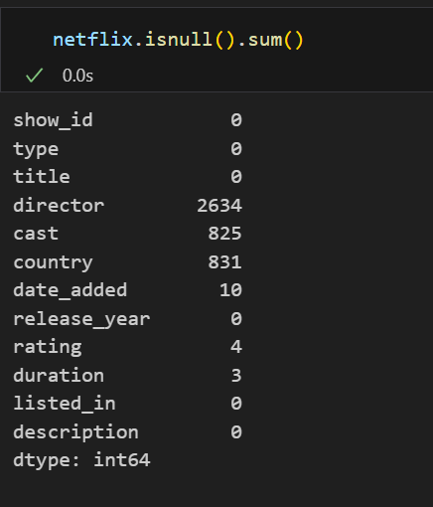
Data cleaning
Finding null values in data:-
There are maximum null values in director column
And after that in cast and country .
In date_added, rating and duration there are very less null values.

Slide 13
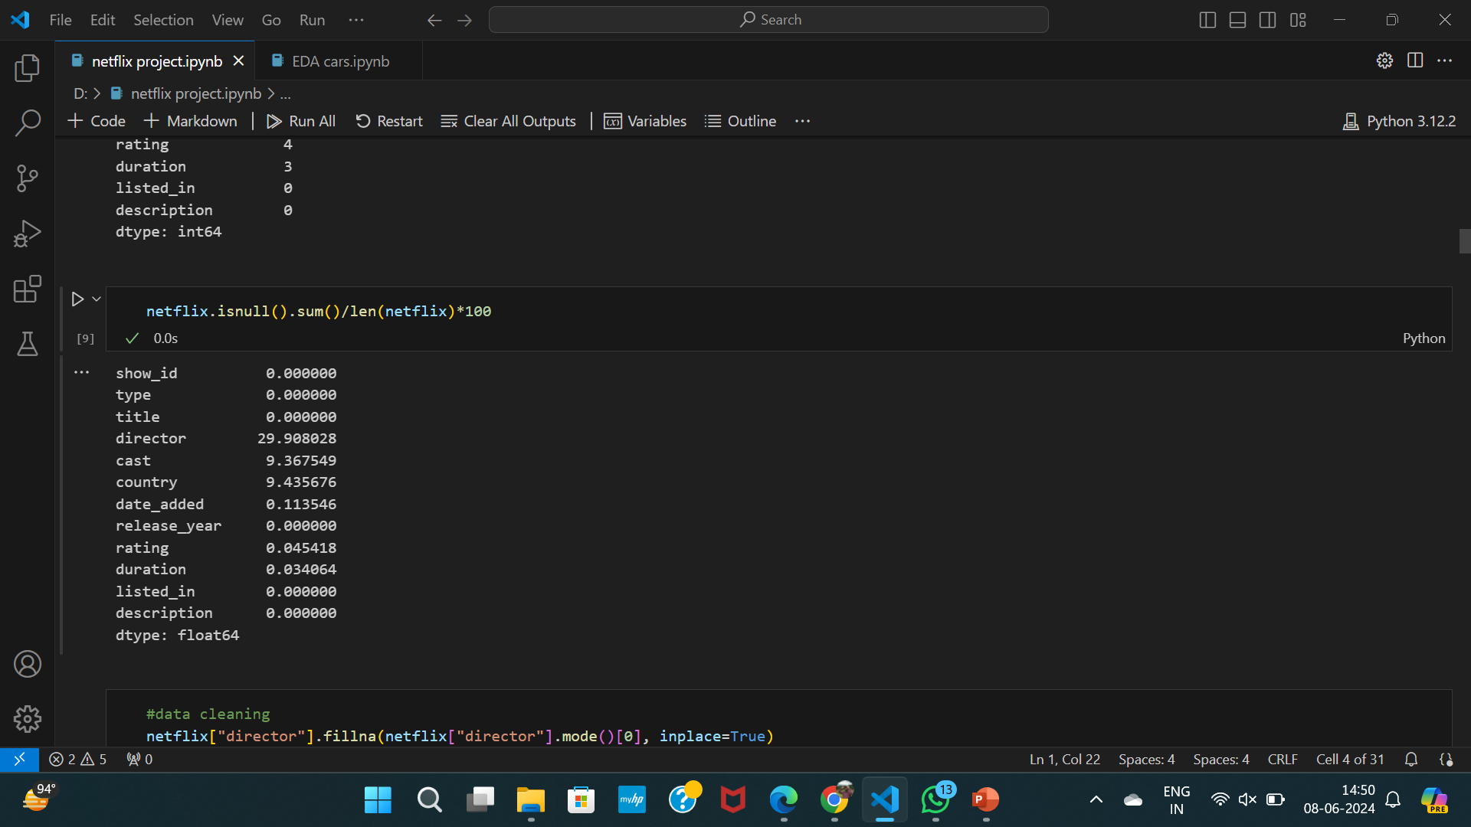
Finding null values in percentage

Slide 14
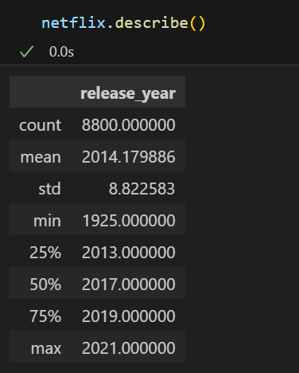
An overview of statistics

Slide 15
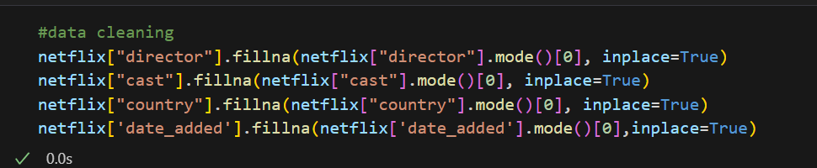
replacing missing values by mode
There are maximum missing values in director and cast country column so we can’t drop it that will impact on our dataset so replacing the missing values with mode.

Slide 16
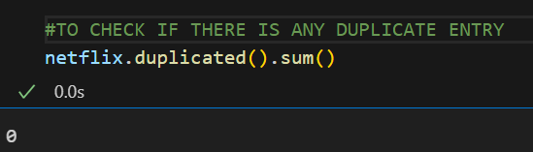
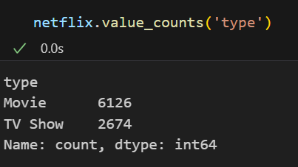
TO KNOW ACTUAL VALUE COUNT OF HOW MANY MOVIES AND HOW MANY TV SHOWS ARE THERE I HAVE USED VALUE COUNT FUNCTION

Slide 17
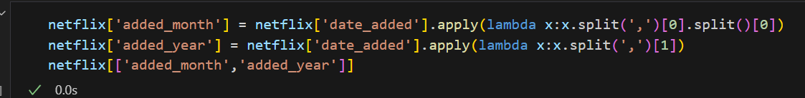
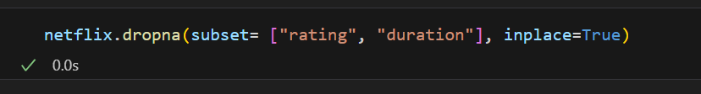
There is column of date_added in existing data but in that we have date month and year in common table so I have splitted that column and made two new columns which are added_month and added_year
And there are 4-5 values are missing in rating and duration so we have droped those missing values

Slide 18
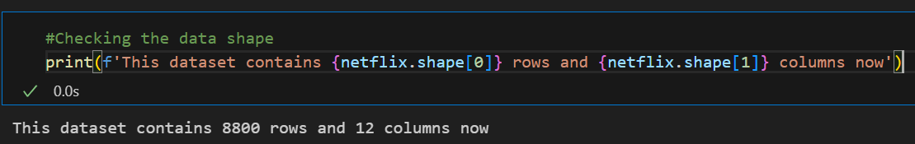
Here is another syntax for checking exact rows and columns or shape of data after cleaning data

Slide 19
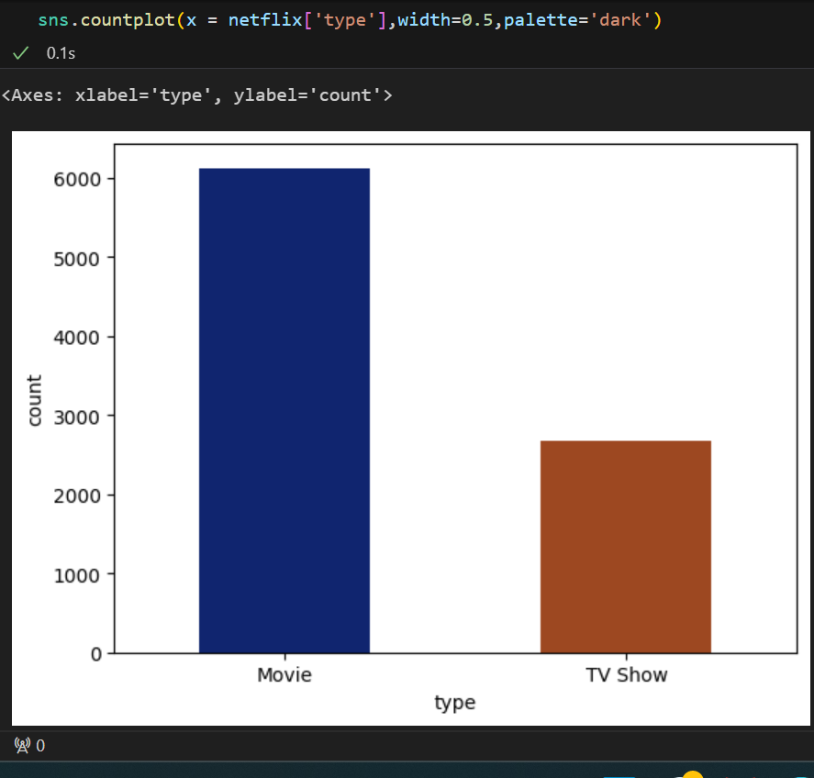
Question 1. What is the distribution of content types on Netflix?
There are maximum movies content is present on Netflix than tv shows there are 6126 movies and 2674 tv shows

Slide 20
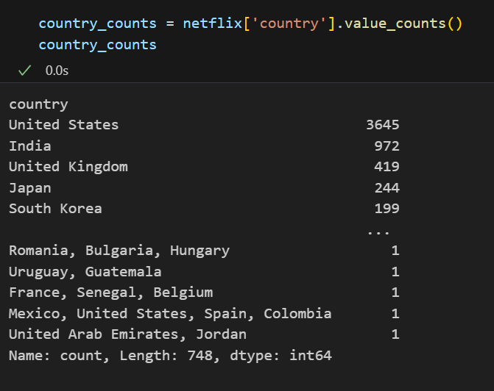
Question 2. Which country produces the most content on Netflix?

Slide 21
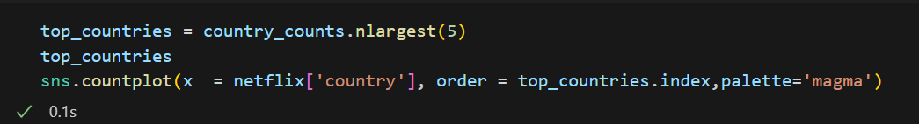
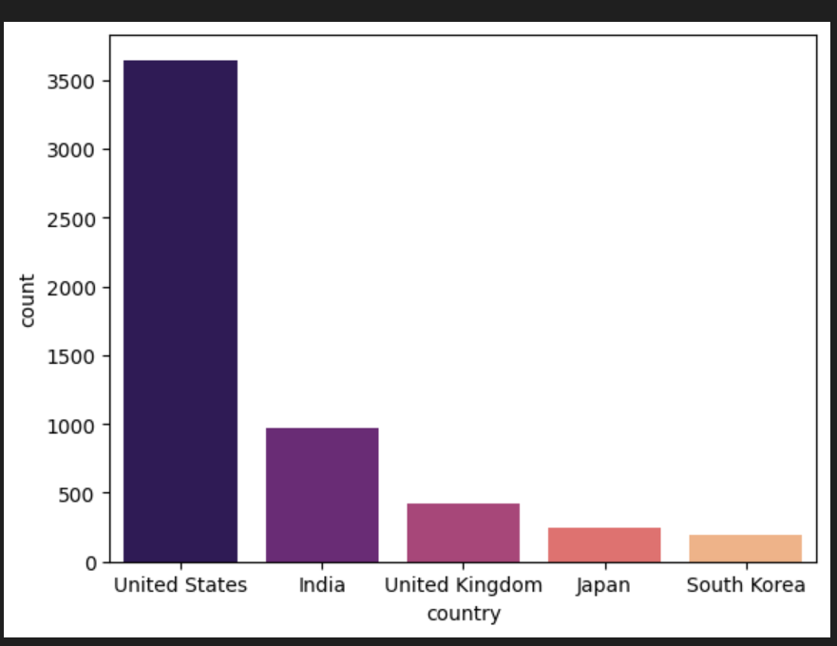
ans:- The United States is the leading content producer on Netflix, followed by India, the United Kingdom, and Japan.

Slide 22
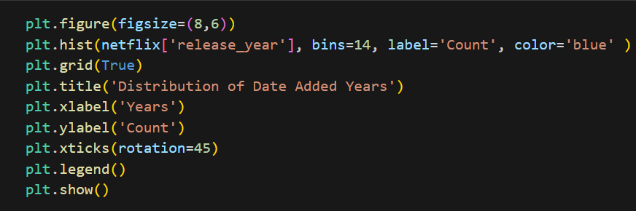
Question no3.In which year most movies are released?
To know in which year most of the movies are released I have ploted histplot and given title as distribution of date added years.

Slide 23
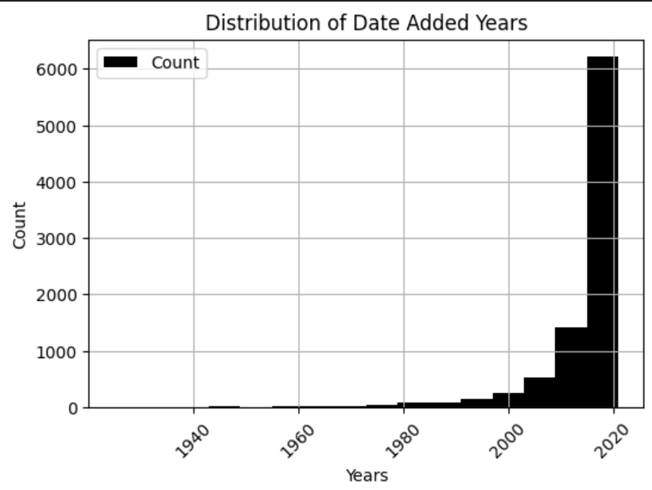
Maximum movies released in between 2020 to know exact year we have ploted another bar plot

Slide 24
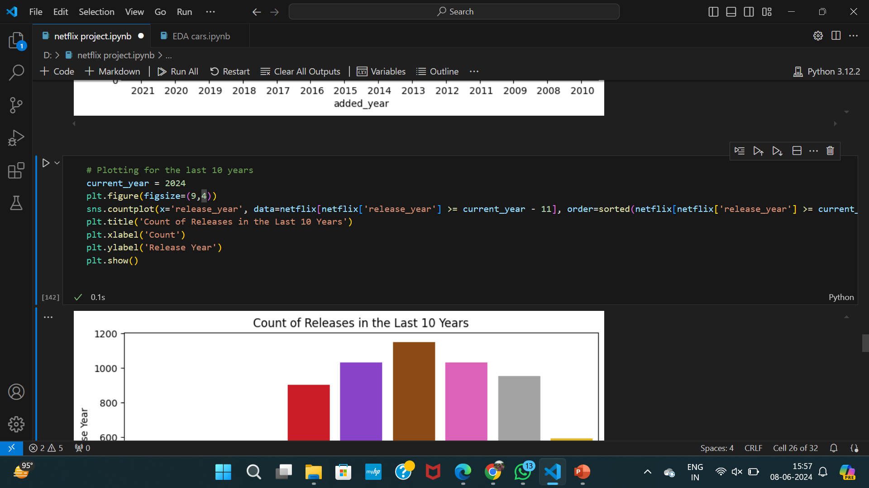
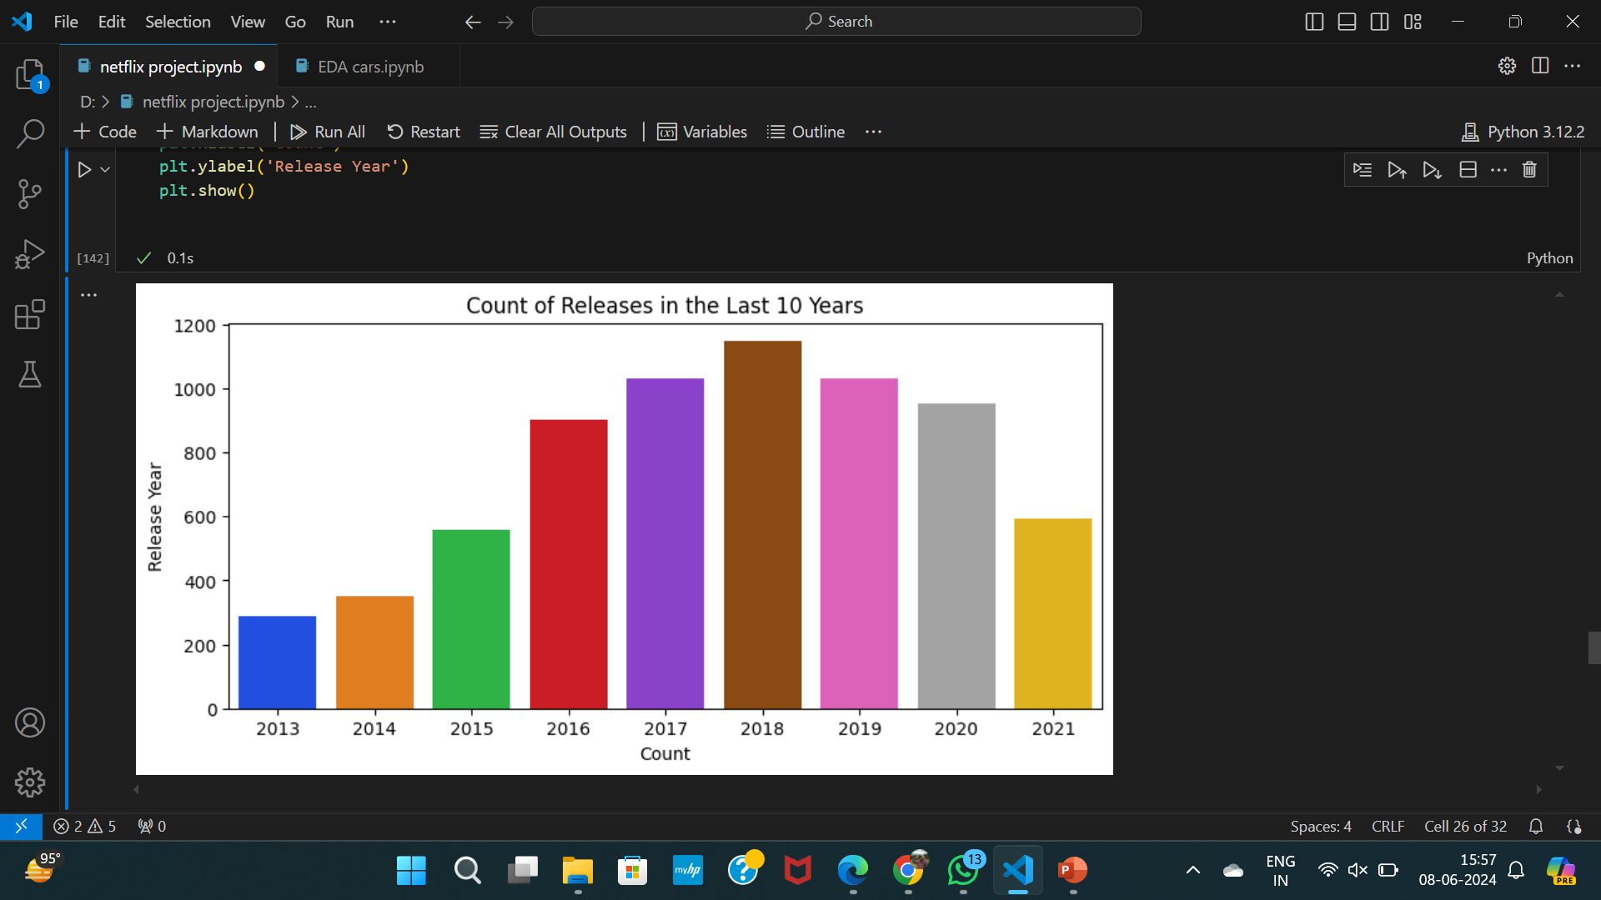
Maximum movies are released in the year 2018.

Slide 25
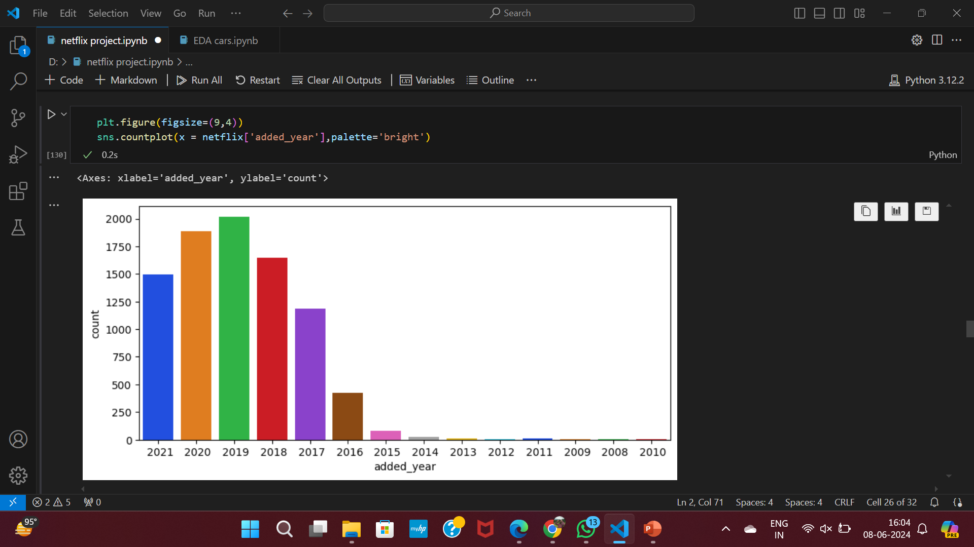
Question no3.In which year most movies are added on netflix?
Maximum movies added on Netflix are in the year 2019.

Slide 26
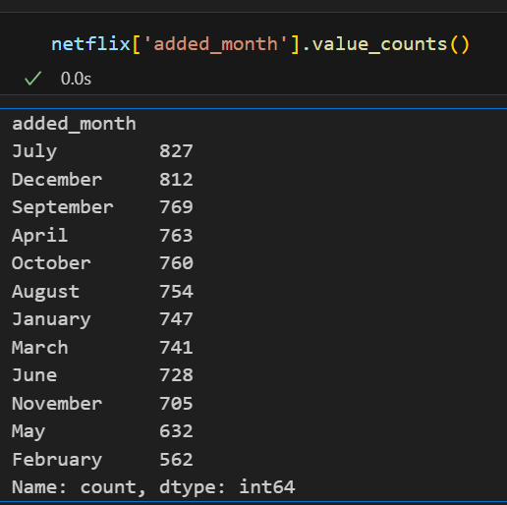
Q no 4.In which month maximum movies are added on Netflix?
From the given data we can find that maximum movies are added in July and December month.

Slide 27
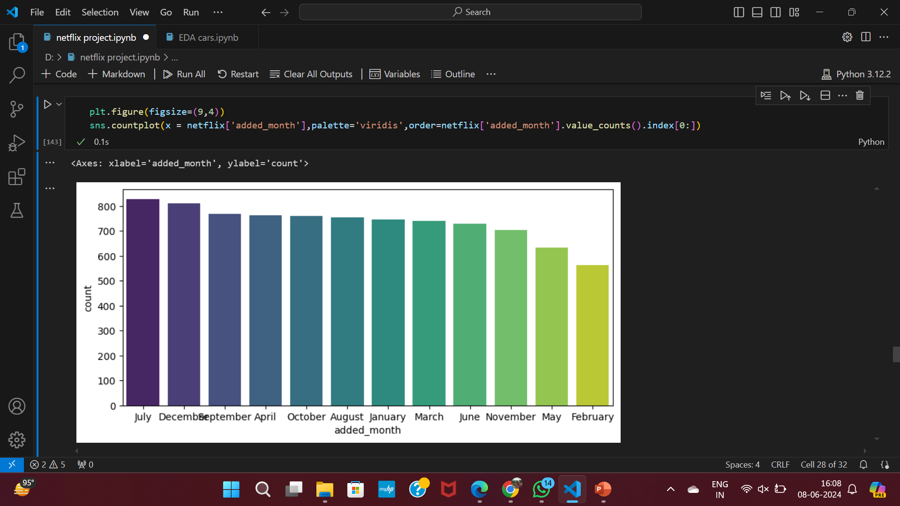

Slide 28
Why maximum movies released in July and December?
Movies are strategically released in July and December due to peak holiday seasons and favorable weather conditions. July, during summer vacation, sees higher foot traffic in cinemas, making it ideal for blockbuster hits aimed at families and younger audiences. December benefits from the winter holiday season, where festive spirit and extended breaks encourage moviegoing. Additionally, December releases can gain momentum for award season considerations, maximizing their visibility and potential for critical acclaim.

Slide 29
Question no 5.Which type of content have maximum rating?

Slide 30
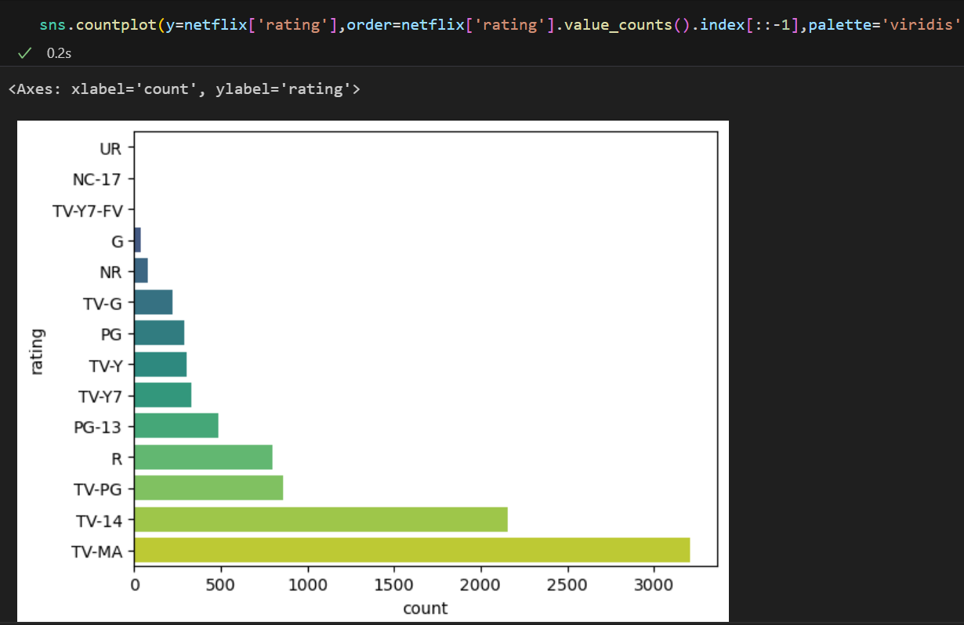
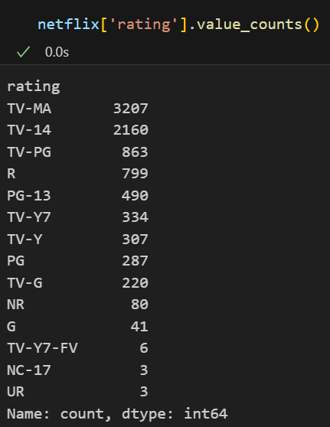

Slide 31
The most common ratings for shows on Netflix are 'TV-MA' and 'TV-14. TV-MA (Mature Audience): With 3207 entries, TV-MA dominates the ratings, indicating a substantial demand for adult-oriented content. This category often includes coarse language, explicit sexual content, nudity, or intense/graphic violence.The high count suggests a significant audience above 18 years old. TV-14 (Parents Strongly Cautioned): Following closely, TV-14 with 2160 entries signifies content suitable for viewers 14 years and older. Given that these programs may contain material parents find unsuitable for children under 14,it highlights a sizable teenage audience. Investing in content for this demographic could be strategically advantageous.

Slide 32
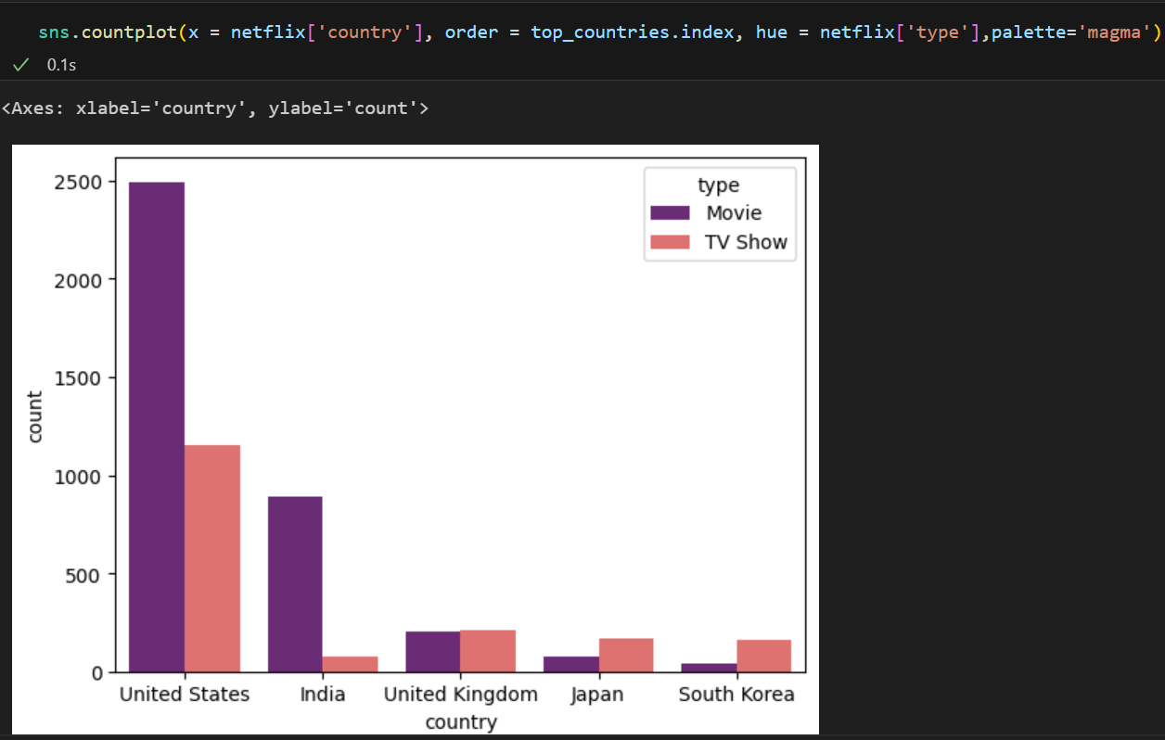
Question no 6.what Type of content is created according to country?

Slide 33
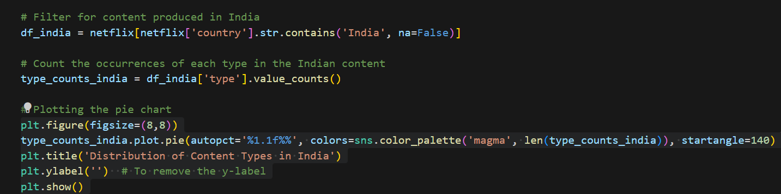
Question no 7.Which type of content is most popular in india ?

Slide 34
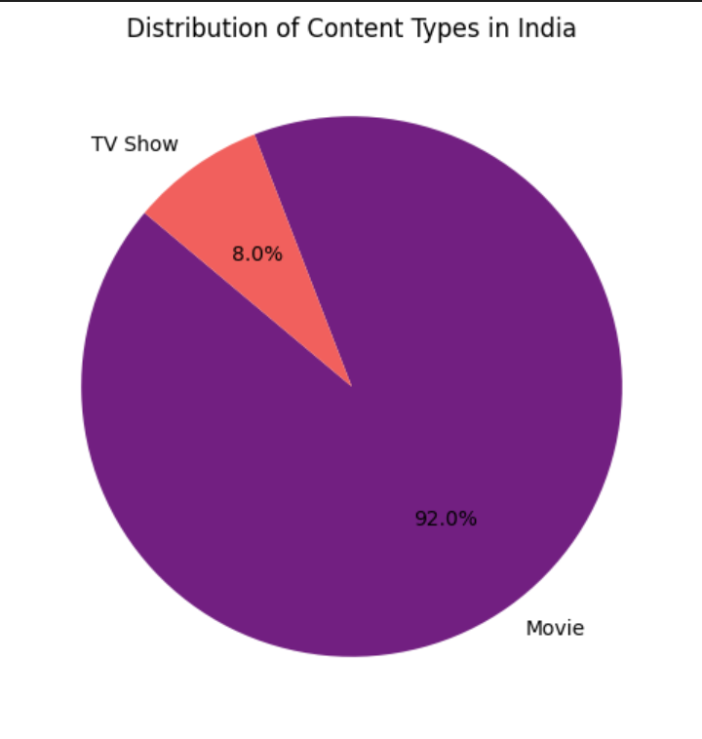
Ans:- there are movies content famous in india than the tv show ,we can see in this pie chart that in india 92% movies are released and 8% of tv shows.

Slide 35
summery
The Netflix dataset has 8807 entries: 6126 movies and 2674 TV shows.
The peak release year is 2018.
Top countries are the USA, India, and the UK.
Popular ratings are TV-MA and TV-14, with common genres being dramas, comedies, and documentaries, showcasing Netflix's diverse and global content.

Slide 36
conclusion
The Netflix dataset reveals a dynamic and expansive content library, with a strong emphasis on movies, particularly in recent years. The diversity in genres, ratings, and international representation highlights Netflix's strategy to cater to a broad, global audience. This rich variety ensures that Netflix remains a leading platform for entertainment, appealing to diverse tastes and preferences worldwide.

Slide 37


